Slide 1
Week 2 - CYBS 3743: Cyberforensics Fundamental
January 28th 2025
Sungbo Jung

Slide 2

Learner’s Ethics
Do the Right Thing!
Images from https://boardagenda.com/

Slide 3
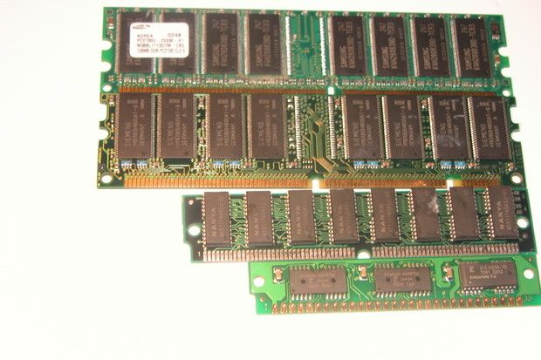
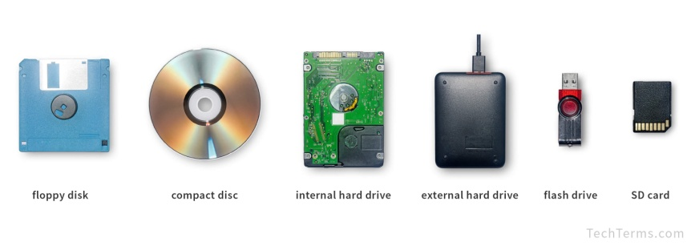
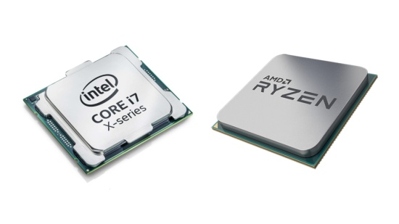
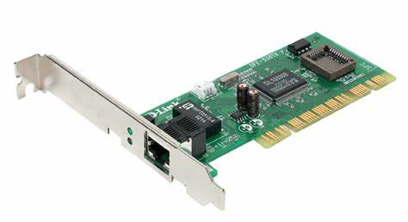
Computer Components
S/W
Data
Socket
User
Application
File
Kernel (O/S)
H/W
RAM
Volatile Memory
Disk Drives
Non-Volatile Memory
CPU
NIC

Slide 4
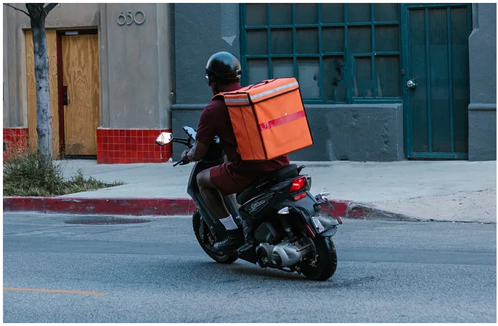
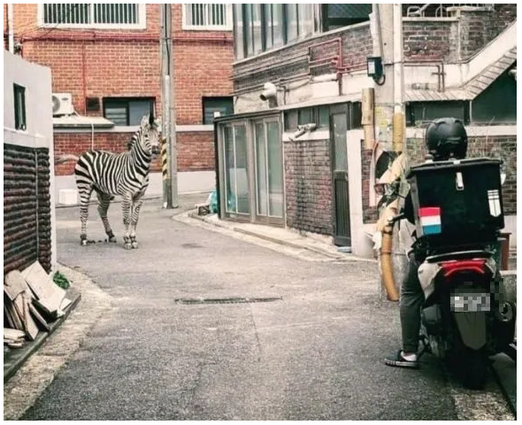
Why is my Doordash too late?
https://www.youtube.com/watch?v=BrwjWbVT85g
Images from https://medium.com/
Images from https://www.khan.co.kr/

Slide 5
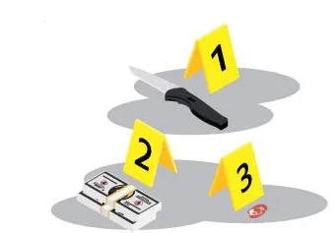
Evidence
Any material presented to establish facts or support arguments
Determine if a legal claim is valid or invalid
Prove criminal intent or alibi
Establish the truth of facts based on the evidence
The legitimate methods of collecting evidence
Evidence that can lead to bias and misunderstandings (although it is critical for the case) cannot be accepted
No tampering and contamination

Slide 6
Evidence in Case
Admissibility of Evidence
A piece of evidence can be legally accepted and considered by the court
Probative Value of Evidence
The strength or weight of the evidence in proving a fact or issue in the case

Slide 7

Category of Evidence
Testimony
Statements made by witnesses under oath during a trial
Provides firsthand accounts of events or facts relevant to the case
Physical Evidence
Tangible items that can be presented in court to support or refute claims
Provides concrete, material proof of facts or events
Documentary Evidence
Written or printed materials that are relevant to the case
Provides documentation or records that can help establish facts

Slide 8
Digital Evidence
Any information stored or transmitted in digital form that can be used to investigate and analyze cyber crimes or incidents
How to store?
Media
Data type
How to generate
Stored Evidence
Generated Evidence

Slide 9
TYPE of Evidence
Direct Evidence
Circumstantial Evidence
Physical Evidence
Documentary Evidence
Testimonial Evidence
Expert Evidence
Digital Evidence

Slide 10
TYPE of Digital Evidence
Type of Evidence | Context
Emails | Communication records, timestamps, attachments
Text | Messages
Social | Media Posts
Computer Files | Documents, spreadsheets, images, metadata
Metadata | Information about data (timestamps, GPS, etc.)
Logs | System logs, access logs, transaction logs
Multimedia Files | Images, videos, audio recordings
Database Records | Transactional data, customer records
Web Browsing History | URLs visited, timestamps, search queries
Volatile Data | Data stored in RAM (e.g., active processes)

Slide 11


